Slide 1

Stay on Track
February 2022
Notes:
You can use these slides to educate and inform current Oregon Promise recipients and other community college partners about how to be successful and retain the grant. Please do not edit these slides without permission from OSAC – email OregonPromise@hecc.oregon.gov or call (541) 687-7400. These slides are a product of the Office of Student Access and Completion (OSAC), an office of the Higher Education Coordinating Commission (HECC).

Slide 2
AGENDA
Overview & Support
How to Renew & Remain Eligible
Understanding Your Award Amount
Special Situations
Questions
Notes:
If you want to learn more in-depth about other topics, view the other videos available on the OSAC Oregon YouTube Channel
Select the “Oregon Promise Playlist” for other videos on how to apply, how to complete GPA verification, and other key topics.

Slide 3
REMEMBER THESE FOUR THINGS
Submit the FAFSA/ORSAA by JUNE 1 each year
Read all emails from OSAC and your college
Stay in school: fall, winter, spring
Keep your grades up
Be sure to list at least one Oregon Community College on your FAFSA/ORSAA
Check your OSAC Student Portal account often and keep your email up-to-date. Also check your college account frequently for updates/messages
Continuous enrollment is required for renewal of the grant. You must attend at least halftime (6+ credits) fall, winter, spring terms
Students must meet Satisfactory Academic Progress to receive Oregon Promise
Notes:
If you remember nothing else from this presentation, remember these four points!

Slide 4

OVERVIEW & SUPPORT

Slide 5

YOU ARE OREGON PROMISE
What is Oregon Promise?
You represent over 10,000 students across 17 community colleges in Oregon
Oregon Promise is a state grant that helps cover tuition at any Oregon community college for recent high school and GED® graduates
P[
Notes:
What is Oregon Promise? You represent over 10,000 students across 17 community colleges in Oregon. Your community and state are committed to seeing you succeed in college and beyond!
Oregon Promise is a state grant that helps recent high school graduates and GED completers pay for community college tuition in Oregon.

Slide 6
OSAC WEBSITE
You can learn more about the grant and eligibility requirements on our website
Visit the “Oregon Promise FAQs” page
Visit the “Information for Current Recipients” page
OregonStudentAid.gov
Notes:
You can learn more on our website: OregonPromise.org or OregonStudentAid.gov.
Visit the “Oregon Promise FAQs” page: https://oregonstudentaid.gov/oregon-promise-faq.aspx
Visit the “Information for Current Recipients” page: https://oregonstudentaid.gov/oregon-promise-recipients.aspx

Slide 7
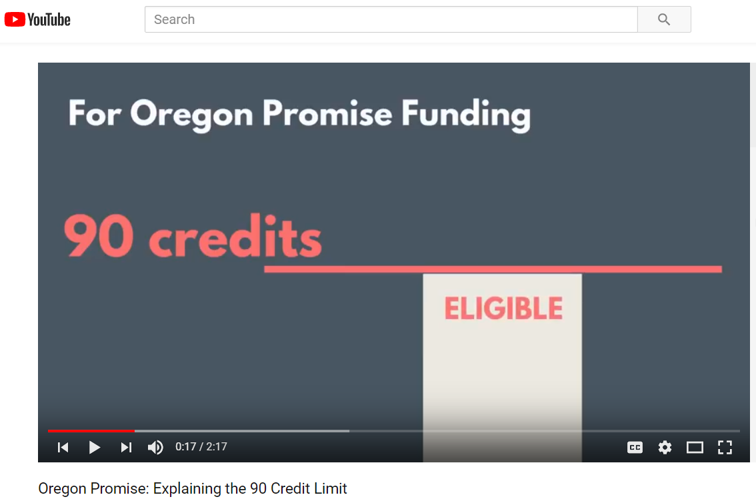
OSAC Oregon YouTube Channel
There are several videos on our YouTube Channel to help you navigate college financial aid
90 Credit Limit
How Much Money Will I Receive
Playlist of FAFSA videos
And more!
Notes:
Check out this short video that explains the Oregon Promise 90 credit limit, and more, on the OSAC YouTube Channel

Slide 8
NEED SUPPORT?
Contact OSAC
  OregonPromise@hecc.oregon.gov
  (541) 687-7400, press 1
  Visit Info for Recipients page on OSAC site
Contact your college Financial Aid Office
Notes:
If you have questions at any time, contact OSAC and/or talk to your college Financial Aid Office. We’re here to support you!

Slide 9

HOW TO RENEW & REMAIN ELIGIBLE
Notes:
Each fall that you are attending a community college, your Oregon Promise Grant may be renewed if you meet certain criteria. This is called your “renewal” award.

Slide 10


HOW DO I RENEW THE OREGON PROMISE GRANT EACH YEAR?
Submit the FAFSA or ORSAA by JUNE 1
No other application is required
If selected for FAFSA verification, you must submit all requested documents to your college financial aid office. If you don’t complete this by fall term, your award will be cancelled.
VERIFY
Notes:
After the first year that you apply for Oregon Promise and are awarded the grant, you do NOT need to complete an Oregon Promise application again. You must file the FAFSA or ORSAA for the following year by June 1, and list at least one community college.

Slide 11


WHEN WILL I KNOW IF I RECEIVE OREGON PROMISE NEXT YEAR?
OSAC will start awarding renewal students in mid-June.
Keep your email address updated in the OSAC Student Portal – check your email for an award notification.
Notes:
OSAC will begin sending emails to students in mid-June about renewal awards, using the email associated with the student’s OSAC Student Portal account.

Slide 12
WHICH TERMS AM I REQUIRED TO ATTEND?
Fall Term
Winter Term
Spring Term
Summer is NOT required – Oregon Promise does not pay for summer classes.
However, summer credits DO count toward the 90 credit limit.
Notes:
In order for Oregon Promise to be renewed the following year, you MUST be enrolled in fall, winter, and spring term. Summer is optional, but those credits are counted toward the 90 credit limit.

Slide 13
HOW MANY CREDITS DO I NEED TO TAKE EACH TERM?
Minimum of 6 credits per term
You’ll receive different award amounts based on how many credits you attempt.
Not covered by Oregon Promise
12 Cr.
9-11 Cr.
6-8 Cr.
Notes:
You must take 6 credits or more per term to receive the grant, and be eligible for renewal. OSAC will only consider exceptions to this requirement if the student experiences a serious illness/injury, a family member death/serious illness or injury, physical natural disaster, military duty or training, etc.
Talk to your Financial Aid office to find out your exact award amount – but partial awards are approximately 50% (6-8 credits) or 75% (9-11 credits) of the full-time award amount.

Slide 14
WHEN DO I HAVE TO COMPLETE FIRST-YEAR EXPERIENCE (FYE)?
During your first three terms of Oregon Promise.
FYE helps you to be a successful college student. Each college has a unique FYE program. To learn more about the requirement, talk to your college Financial Aid Office.
Notes:
First-Year Experience is different at each community college; it could be an orientation session, credit course, online learning, etc. You must complete FYE during your first three terms in Oregon Promise, or your grant will not be renewed.

Slide 15
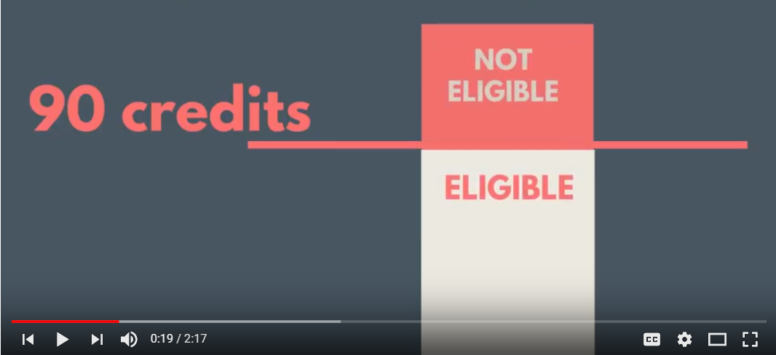
TRUE OR FALSE?
I can only receive Oregon Promise for two years.
FALSE. You can receive Oregon Promise until you have a total of 90 attempted college credits.
You might receive Oregon Promise for less than two years or more than two years – it depends on how quickly you take credits.
Watch the 90 Credit Limit Video
Notes:
All of the following types of credits may count toward the 90 credit limit:
College credits you take while in high school or as part of a high school completion program
College credits you take during summer term*
College credits you take at another college or university while dual-enrolled at a community college
College credits for courses you withdraw from or fail
Advanced Placement (AP) or International Baccalaureate (IB) credits earned
Any other college credits you attempt or complete prior to and during your time as an Oregon Promise recipient

Slide 16

90 CREDIT LIMIT
All college credits attempted count toward the 90 credit limit, including credits taken in high school.
Once a student has attempted 90 college credits, they will no longer receive Oregon Promise awards.
EXAMPLE:
90 - 10 = 80 credits
High School Student
Oregon Promise will cover up to 80 under Oregon Promise.
Takes 10 college level credits.
Notes:
A student’s eligibility may run out partway through a school year, since it depends on when they reach the 90 credit limit.

Slide 17

UNDERSTANDING YOUR AWARD AMOUNT

Slide 18
AWARD AMOUNTS FOR FULL-TIME STUDENTS
Awards range from $1,000 to $4,131* per year
Award amounts will vary each year based on tuition costs, and are subject to legislative approval
*Maximum award for 2021-22 academic year
Notes:
This is the range of full-year award amounts for Oregon Promise students in 2021-22 (before the co-pay is removed). These are the award amounts if the student attends Full Time (12 or more credits) – if they take between 6-11 credits, they will receive a lower award amount.
A student’s Oregon Promise award can change each year that they are in college (or from term to term). Let’s explore the different factors that are used to calculate a student’s award amount.

Slide 19
VARYING AWARD AMOUNTS – 4 FACTORS
$50 Per Term Co-Pay
Tuition Cost
Number of Credits
Last Dollar to Federal Pell Grant & Oregon Opportunity Grant
Notes:
Each student’s Oregon Promise award amount is based on a calculation that considers these 4 factors:
1) Co-Pay: A $50 co-pay is automatically deducted from your Oregon Promise award each term.
2) Tuition Cost: Community college tuition cost varies from school to school. Oregon Promise covers up to the average cost of tuition. Tuition at your college may be higher or lower than the average. If you’re going to a more expensive college, then you will likely end up paying more out of pocket. If you are at a less expensive college, your award may be lower than the average tuition.
3) Number of Credits Taken: Oregon Promise covers up to 12 credits per term. You are financially responsible for any credits over 12. If you take 6-11 credits, you will receive a lower award amount.
4) Federal Pell Grant & Oregon Opportunity Grant: Oregon Promise covers remaining tuition amount (up to 12 credits) after any Federal Pell Grant and Oregon Opportunity Grant funds have been applied.

Slide 20



THREE SAMPLE STUDENTS
Student A: Lower Expected Family Contribution
$$$
$$
$
PELL GRANT
(FEDERAL)
OREGON OPPORTUNITY
GRANT(STATE)
OREGON
PROMISE (STATE)
$1,000 minimum
Student B: Moderate Expected Family Contribution
$$
$$
PELL GRANT
(FEDERAL)
OREGON
PROMISE
GRANT (STATE)
Student C: Higher Expected Family Contribution
$$$
OREGON
PROMISE
GRANT (STATE)
$4,131: Average cost for 3 terms @
12 credits (2021-22)
Notes:
This shows three sample students in different financial situations, and how their Oregon Promise award is calculated. The dotted line represents the average community college tuition cost in 2021-22, which may vary each year.
The Expected Family Contribution (EFC) is a number that is calculated based on a federal formula, from data that a student and their family submits via the FAFSA or ORSAA). The EFC is an indicator of a student’s financial need, for financial aid purposes. A lower EFC means greater financial need, and a higher EFC means lower financial need.
Student A has a lower EFC, so they qualify for both the Federal Pell Grant and the Oregon Opportunity Grant. Since their tuition is already covered by these two grants, they automatically receive a minimum Oregon Promise award of $1,000 for the year. The student can use this money to pay for other educational expenses such as fees, books, transportation, housing, or other living expenses.
Student B has a moderate EFC compared to Student A. The student qualifies for some Federal Pell Grant, but does not qualify for the Oregon Opportunity Grant. Oregon Promise fills in the student’s remaining need, up to the average cost of tuition.
Student C has a higher EFC compared to the other two students. This student does not qualify for the Federal Pell Grant or the Oregon Opportunity Grant. They will receive a higher Oregon Promise award, up to the average cost of tuition.

Slide 21




OREGON PROMISE HELPS YOU PAY FOR
TUITION
REMEMBER,
there are other costs to go to college, such as…
Books and Supplies
Fees
Room and Board
Notes:
Oregon Promise helps students pay for community college tuition. Keep in mind that there are other costs of college attendance that students and families need to plan for: room and board, books and supplies, fees, personal expenses, transportation, etc.

Slide 22

SPECIAL SITUATIONS
Notes:
Here are a few unique situations to consider, for Oregon Promise students.

Slide 23
WHAT IF I’M NOT MAKING SATISFACTORY ACADEMIC PROGRESS? (SAP)
Oregon Promise will not pay for credits if you are failing to meet SAP.
To maintain your Oregon Promise renewal eligibility for next year, you must still take at least 6 credits each term.
Work with your college Financial Aid Office on a SAP appeal, or any other requirements to get back on track.
!
Notes:
Each college has their own definition of Satisfactory Academic Progress. Talk to your college to learn more.
If a student is not meeting SAP, then they can still be eligible for a renewal grant, if they stay enrolled in at least 6 credits each term. They will have to pay for the term on their own.

Slide 24
WHAT SHOULD I KNOW IF I’M DUAL ENROLLED?
Be sure to complete your school’s dual enrollment process and list your community college as your home college.
Oregon Promise only pays for credits you take at the community college.
However, credits taken at both colleges count toward the 90 credit limit for Oregon Promise.
Notes:
You can be dual enrolled or in a Degree Partnership Program (DPP) and receive Oregon Promise. Please work closely with both colleges to ensure that you meet the following requirements:
Establish a dual enrollment agreement between the two schools
Have the community college listed as your home college for financial aid purposes
Attempt at least 6 credits at the community college each term
Oregon Promise will only pay for the credits you take at an Oregon community college. However, credits completed at both schools will count toward the 90 credit limit allowed by Oregon Promise.
If you are dual enrolled between multiple community colleges in Oregon, make sure that a dual enrollment agreement is in place. You may be able to receive Oregon Promise funds to cover credits taken at both community colleges. Contact OSAC or your financial aid office for assistance.
If you are dual enrolled, please contact your community college financial aid office.

Slide 25
WHAT IF I TRANSFER TO ANOTHER COMMUNITY COLLEGE?
Be sure to update your college list on your FAFSA or ORSAA immediately to add your new college.
Follow up with your new Financial Aid Office at the college, to make sure that you have completed all requirements.
Notes:
You can keep receiving Oregon Promise if you transfer from one community college in Oregon to another. The only steps needed are:
Add the community college to your FAFSA/ORSAA as soon as you know you’re going to transfer
Be sure to follow-up with the new college to complete all requirements to receive financial aid, including Oregon Promise

Slide 26
REMEMBER THESE FOUR THINGS
Submit the FAFSA/ORSAA by JUNE 1 each year
Read all emails from OSAC and your college
Stay in school: fall, winter, spring
Keep your grades up
Be sure to list at least one Oregon Community College on your FAFSA/ORSAA
Check your OSAC Student Portal account often and keep your email up-to-date. Also check your college account frequently for updates/messages
Continuous enrollment is required for renewal of the grant. You must attend at least halftime (6+ credits) fall, winter, spring terms
Students must meet Satisfactory Academic Progress to receive Oregon Promise
Notes:
If you remember nothing else from this presentation, remember these four points!

Slide 27
QUESTIONS?
OregonPromise@hecc.oregon.gov
(541) 687-7400
OregonPromise.org

